Slide 1

Problem Statement ID: UHCK_IT004
Problem Statement Title
Optimizing Traffic Signal Timing
Team ID: UHCK_NT020
Team Name: Solemn Seekers

Slide 2

Problem Statement
To build a self adaptive traffic light control system based on yolo. Disproportionate and diverse traffic in different lanes leads to inefficient utilization of same time slot for each of them characterized by slower speeds, longer trip times, and increased vehicular
Queuing. To create a system which enable the traffic management system to take time allocation decisions for a particular lane according to the traffic density on other different lanes with the help of cameras, image processing modules.
Abstract
Computer Vision-based traffic light controller that responds to real-time traffic conditions. It uses live CCTV camera feeds
attached to traffic lights to calculate traffic density by detecting different types of vehicles at signals and adjusts green signal
times accordingly The system employs the YOLO AI model to detect vehicles and uses an algorithm to optimize traffic signal
timers based on vehicle density and queue lengths. This approach aims to improve traffic flow, reduce delays, congestion,
waiting time, fuel consumption, and pollution, ultimately enhancing traffic management and transportation efficiency.
Future Scope
Advance signal clearing algorithms for Ambulance.
Self learning Algorithm that will use past data to train itself so that it is still functional when the data is obstructed.
Logging system, to insure that all data gets saved and all be looked into whenever needed.

Slide 3
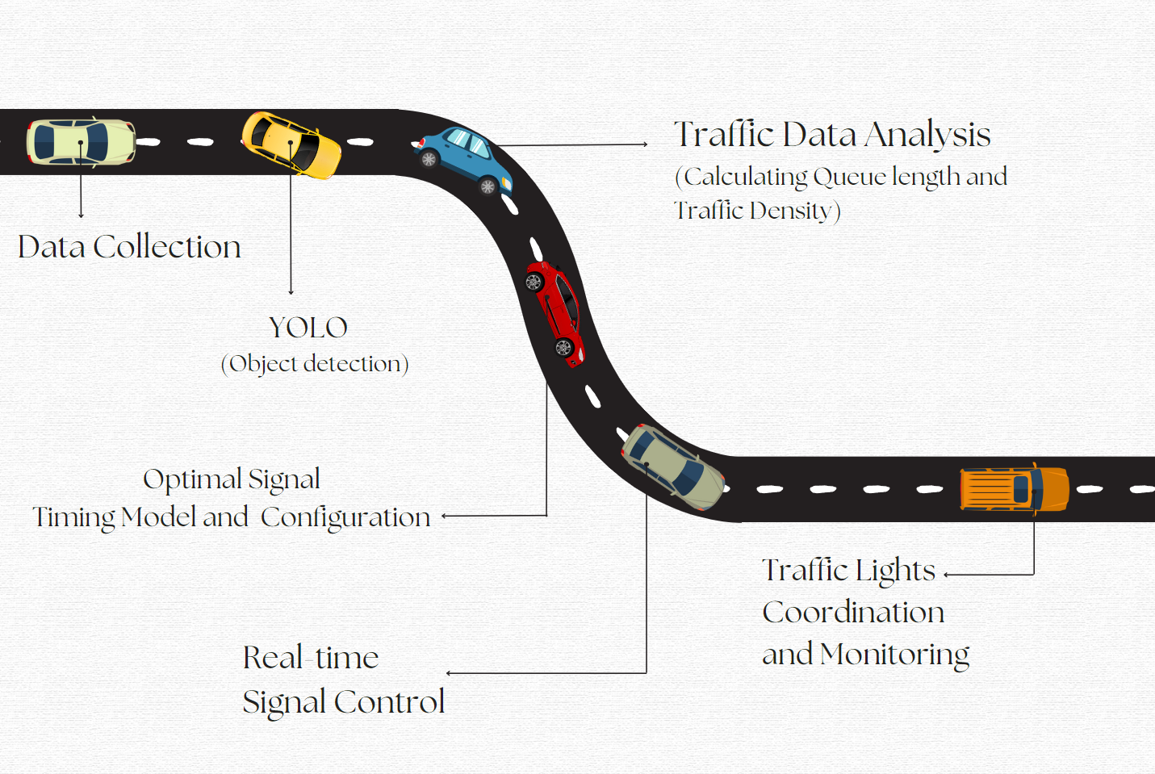
Flowchart (Roadmap of our project)

Slide 4
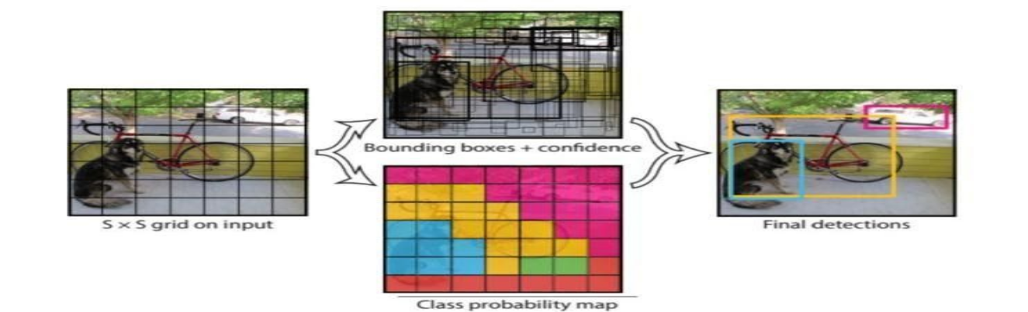
Technology
YOLO, You only look once (YOLO) is a state-of-the-art, real-time object detection system​ YOLO, a new approach to object
detection. Prior work on object detection repurposes classifiers to perform detection. Instead, we frame object detection as a
regression problem to spatially separated bounding boxes and associated class probabilities. A single neural network predicts
Bounding boxes and class probabilities directly from full images in one evaluation. Since the whole detection pipeline is a
single network, it can be optimized end-to-end directly on detection performance

Slide 5
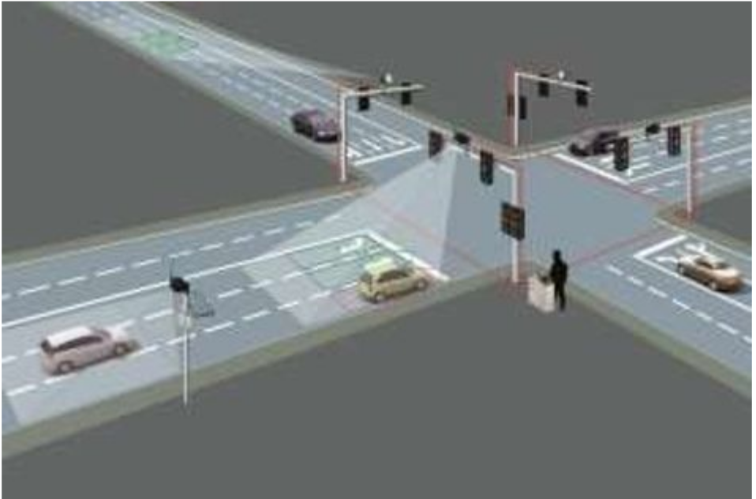
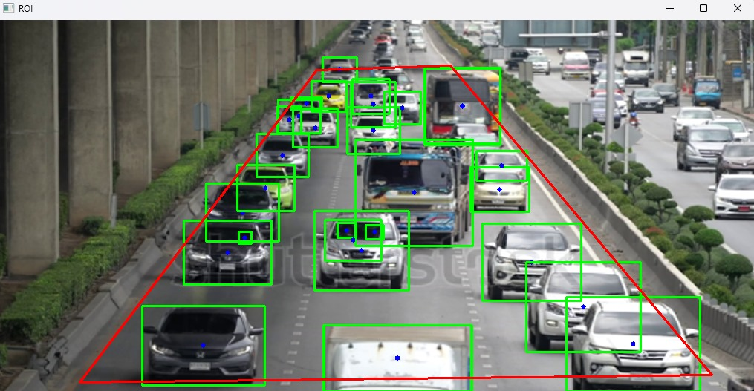
Working
The solution can be explained in four simple steps:
1.Get a real time image of each lane.
2.Scan and determine traffic density.
3.Input this data to the Time Allocation module.
4.The output will be the time slots for each lane, accordingly.

Slide 6
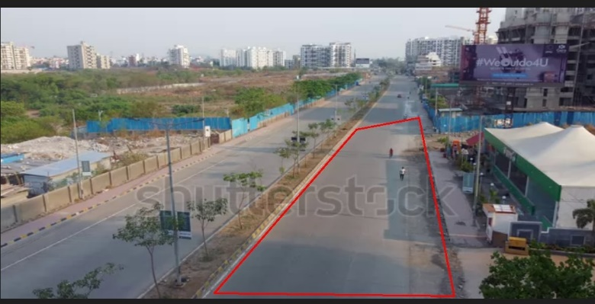
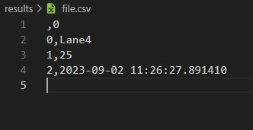
Algorithm – Priority Queue
Traffic Categorization: Categorize traffic conditions.
Signal Adjustment: Dynamically adjust signal durations for optimal traffic flow.
Display: Print updated signal durations for each lane at each intersection.
Repeat: The loop continues to adapt to changing traffic conditions.
Benefits:
Adaptive signal control improves traffic flow
Reduces congestion during peak hours.
Efficient resource utilization without manual intervention.

Slide 7
Thank You
Team ID: UHCK_NT020
Team Name: Solemn Seekers

